Slide 1
The SAR in Rapid Time – overview of process and available tools
[Name of presenter or participating organisation]
[Date]
Notes:
This short slide pack provides an overview of the key tools and how they are used at different points in the review process.

Slide 2
Introduction
Lead reviewers should watch the recorded training modules available here before using the SAR in Rapid Time model:
https://www.scie.org.uk/safeguarding/adults/reviews/in-rapid-time/training
Delivered by Dr Sheila Fish,
Independent Consultant & SCIE Associate
Notes:
Seven training modules are available.

Slide 3
Published examples
Dorset
https://www.dorsetcouncil.gov.uk/documents/35024/281402/Dorset+SAR+Systems+Findings+Report++Katherine+October+14.pdf/df37056a-51cd-68c2-5133-491180d96d51
Newham
https://www.newham.gov.uk/downloads/file/2750/newham-sar-in-rapid-time-peggy
https://www.newham.gov.uk/downloads/file/2751/newham-sar-peggy-system-findings-response
Notes:
A selection of published SAR reports that have used the SAR in Rapid Time methodology.

Slide 4
SAR in Rapid Time and tools
Agenda incl. 10 questions
Project plan template
Share chronology and key records with reviewers; send out invites for meetings
Reviewers produce Early Analysis Report
Structured multi-agency workshop
Set up meeting with leads from involved agencies and reviewers
2
2
5
3
Reviewers produce brief systems findings report
Input from agency leads to confirm systems findings
5
4
Record check template
Invitation email
Early Analysis report template
Agenda template and opener
Feedback form template
Report template
Notes:
This tool outlines the key phases of the review and identifies the tools and templates that can be used to support each phase.

Slide 5
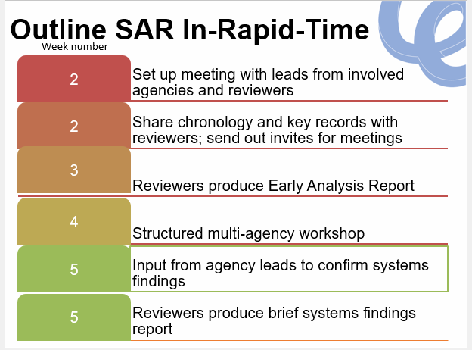
Couched in each SAB’s own processes
Referral
Decision making
Informing & engaging the person, family
Governance
Improvement action
Notes:
The SAR in Rapid Time process can be slotted into the usual SAB processes which are undertaken at the outset to select referrals and engage families and the usual SAB governance processes at the end which subsequently lead to improvements and action planning, following the sign-off of the report by the Board.

Slide 6
Overview of tools to support use of SAR in Rapid Time
Overview graphic and list of tools
Project Plan template
Introduction slides for Senior Agency Leads
Set Up Meeting briefing including the 10 Questions
Agency Record Check template
Invitation email template to workshop
Early Analysis Report template
Workshop agenda template and opening text
Systems findings report template
Systems findings feedback from agency leads template
Notes:
This is a list of the 10 SAR in Rapid Time tools and templates which are now available on the SCIE website at https://www.scie.org.uk/safeguarding/adults/reviews/in-rapid-time/tools-templates

Slide 7
Thank you For more information please visit www.scie.org.uk

