Slide 1
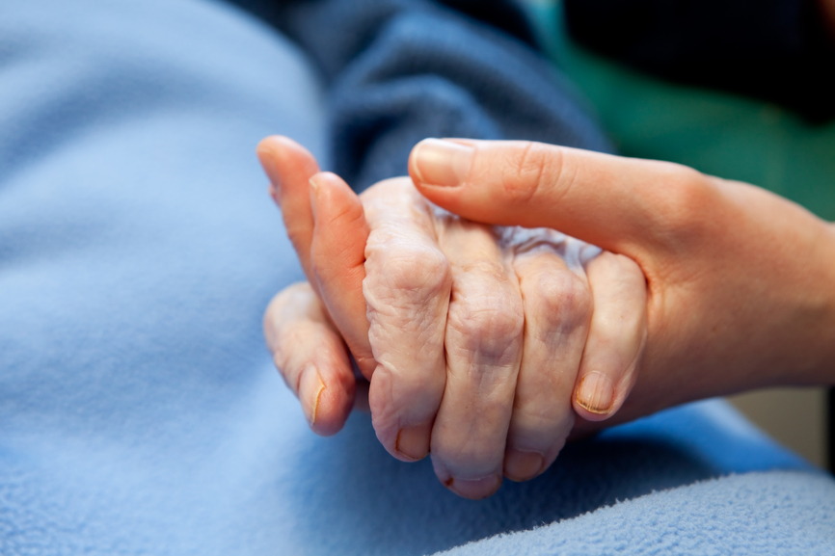
Achievements of the Croydon CCG
Mental Capacity Act & Deprivation of Liberty safeguards project
Project Lead Sylvia Manson and Safeguarding Team would like to share with you our progress with the MCA project and positive outcomes to date.
We have engaged GP Practices, Dentists and Optometrists in Croydon to attend MCA workshops and lectures enabling them to actively participate in developing tools and processes around MCA
We have developed ,consulted and launched a pilot MCA self-assessment tool and Best Interests Form for Primary Care.
We provided guidance and recommendations to CHS and SLaM and gave assurance around new processes that are being developed to strengthen MCA pathways
We have provided the targeted training for CHS, SLaM and reviewed the governance processes around DoLS.
First Phase of the project has just finished, however further work is planned for September onwards -with participation from Croydon Care Homes, SLaM and Croydon GP Network.
If you have any questions in regards to Mental Capacity Act and Deprivation of Liberties Safeguards, please send email to sylmanconsulting@outlook.com
or ewa.koscielniak@croydonccg.nhs.uk
we will be happy to assist you.
See You in September ☺
- Sylvia

